Slide 1
Programming and Algorithm
Lab 5: Basic Algorithm

Slide 2
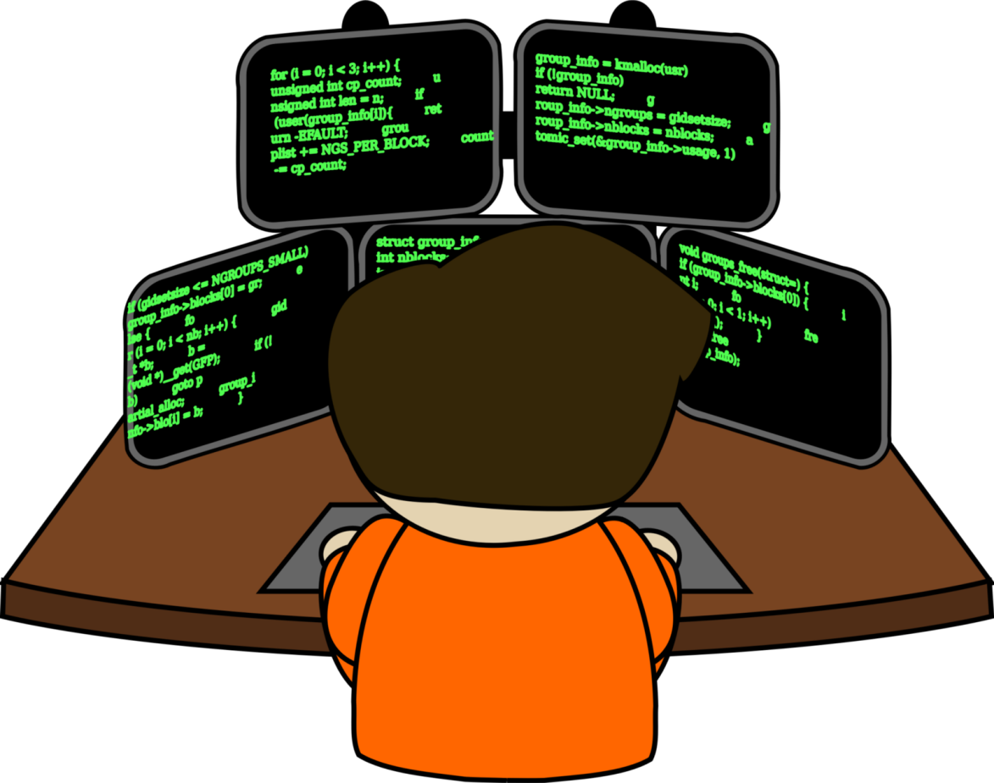

Welcome to Basic Programming Class

Slide 3

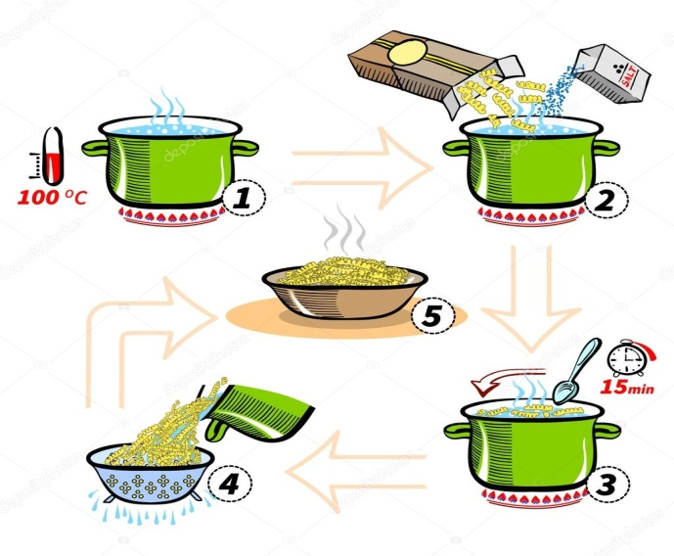
What is Algorithm?
A step by step method of solving a problem. It is commonly used for data processing, calculation and other related computer and mathematical operations.
Ex: Recipe for cooking(real life).

Slide 4
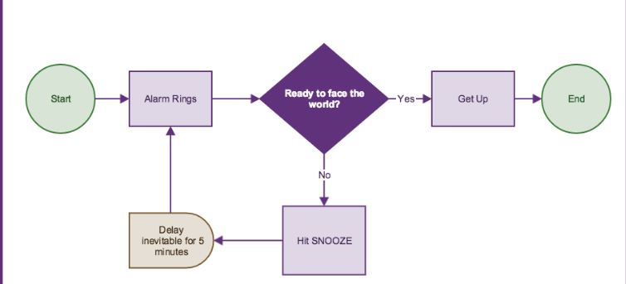
Algorithm in Daily Life?

Slide 5
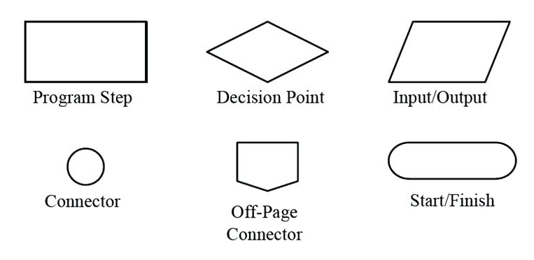
Flowchart Shapes

Slide 6
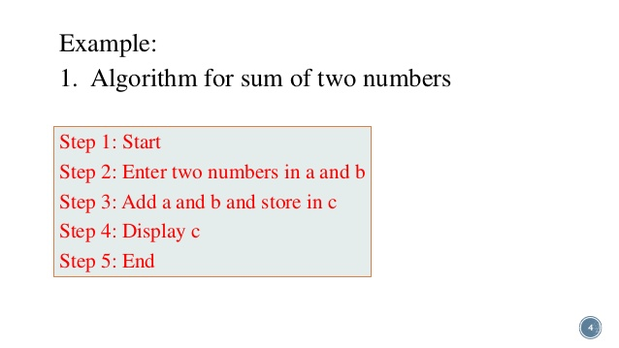
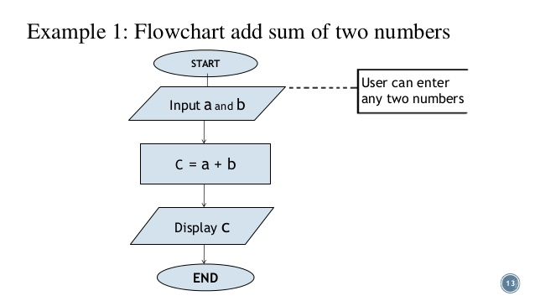
Ex 1: SUM of two number
Algorithm Example

Slide 7
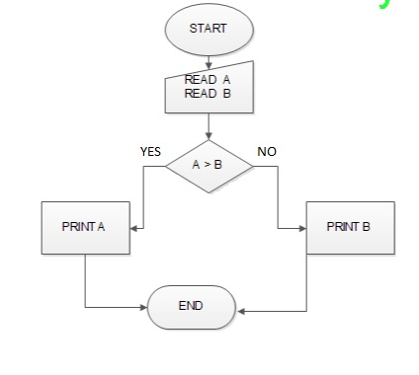
Ex 2: Greater Number!

Slide 8
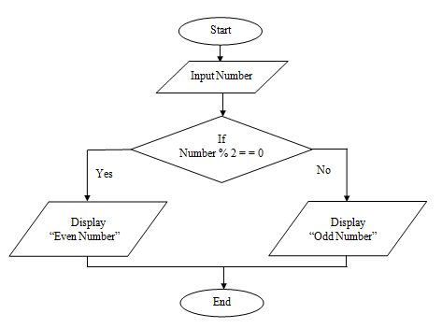
Ex 3: Even and Odd Number!

Slide 9
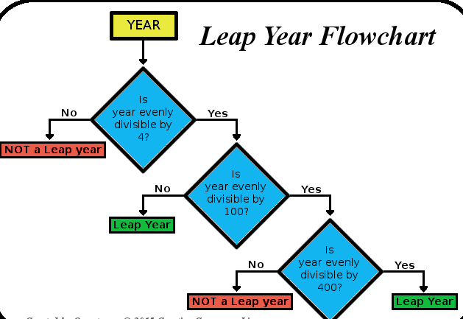
Ex 3: Leap Year!

Slide 10

Today’s learning:
Algorithm
Flowchart
Algorithm Example
Thank You!

